Slide 1
The MagLev Car
The MagLev Makers

Slide 2
What Does This Aim To Solve In Daily Life?
Air pollution is such a pressing issue in the 21st century. Our project aims to reduce the amount of greenhouse gases that vehicles emit into the atmosphere. Our vehicle is battery powered, so it does not release the harmful chemicals that a gasoline-powered car would. Also, the MagLev Car levitates, reducing the amount of friction. This makes the car faster, more fuel efficient, and eliminates road surfacing problems. In conclusion, our Maglev Car aims to decrease vehicle emissions, travel faster, and eliminate road surfacing issues.

Slide 3
How Sophisticated is The Technical Level?
The technical level of the MagLev Car is very advanced, as there is no other car on the market. The vehicle has standard magnets, unlike a MagLev Train that uses electromagnets to attract and repel. This car is also powered by a fan, unlike most electric cars that use 4 motors to turn wheels. Along with that we a sophisticated weight sensing system, that is unique to our vehicle. This weight system uses the amount of weight in the car to turn the fan on or off, thus “turning on” or “stopping” the car.

Slide 4
What Is The Value of the Project?
Our vehicle is very valuable, considering that it is environmentally friendly. Many people would like to protect the environment, and one way to do that is by driving an environmentally friendly car. If the MagLev car became a normality, car emissions would decrease greatly. Also, our car is cost effective. While it does not require a fuel tank, it needs magnets to levitate, so it should cost about the same amount as a normal car. Although it may be more expensive to buy in the present, in the long-run it will provide a cheaper system, and a more environmentally friendly option. A buyer of the MagLev Car would get more out of the vehicle than they would a normal car. In conclusion, the MagLev Car is cost efficient and environmentally friendly.

Slide 5
Improvement Plan
In the future, we plan to change the speed of the car depending on how much weight is added to the vehicle. We hope to achieve this by improving the weight sensor for something more appropriate with a large vehicle. Also, we would like to apply this project to real life. We would do this by incorporating magnets into roads and collaborating with a major car manufacturer to put the MagLev Car into circulation.

Slide 6
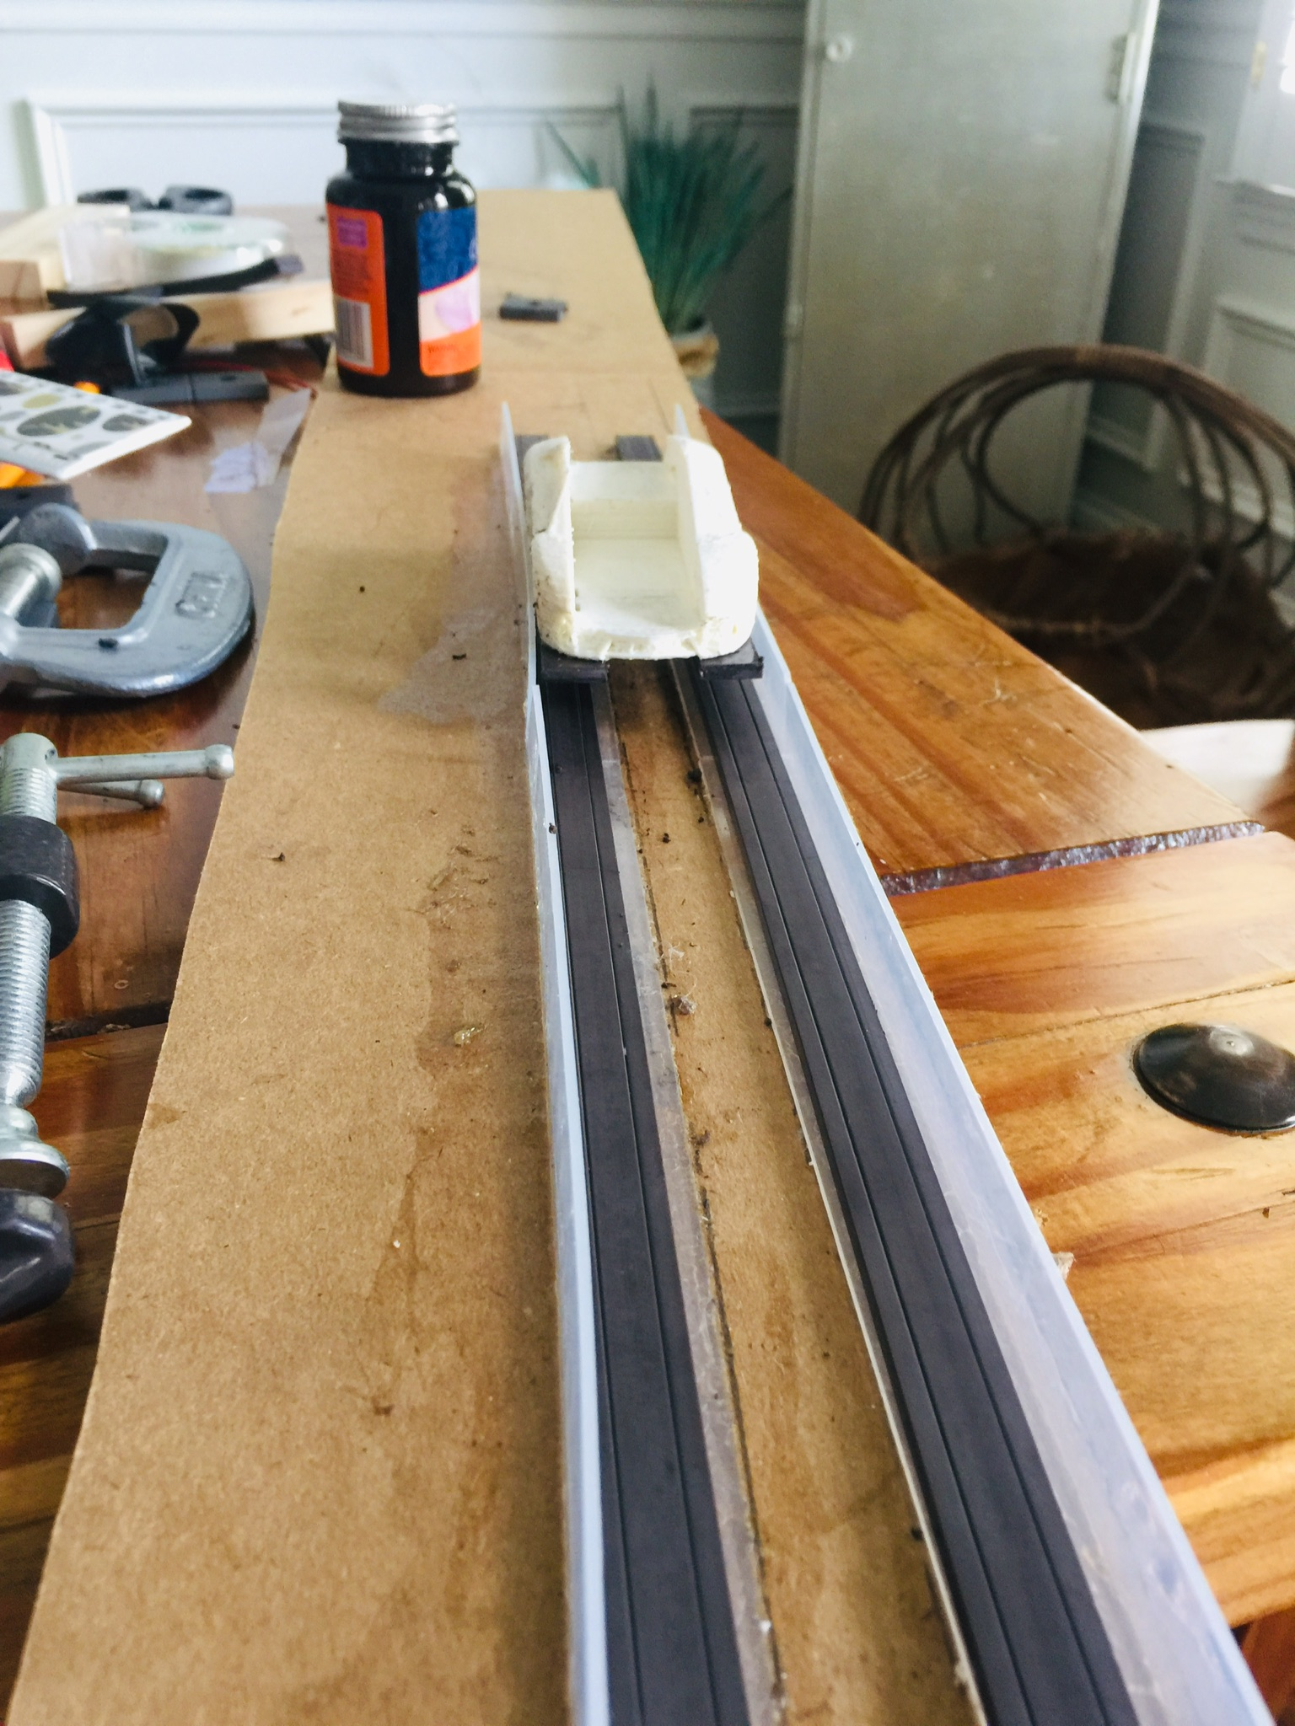
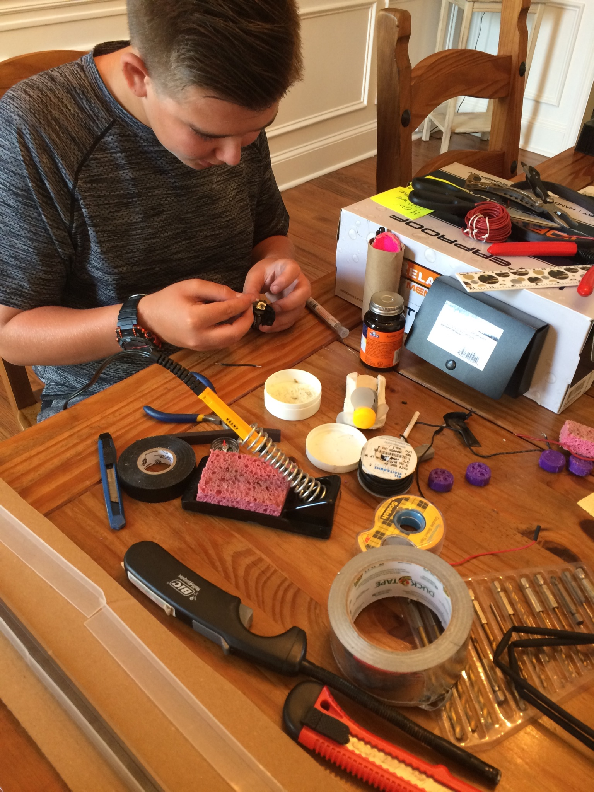
Leland soldering a wire to the battery pack.
The MagLev Car levitating on its track.

Slide 7
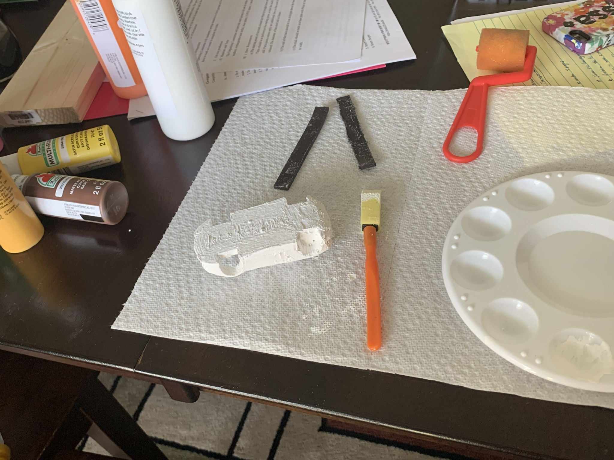

Carissa working on the presentation.
Preparing to paint the car without the magnets attached.

Slide 8
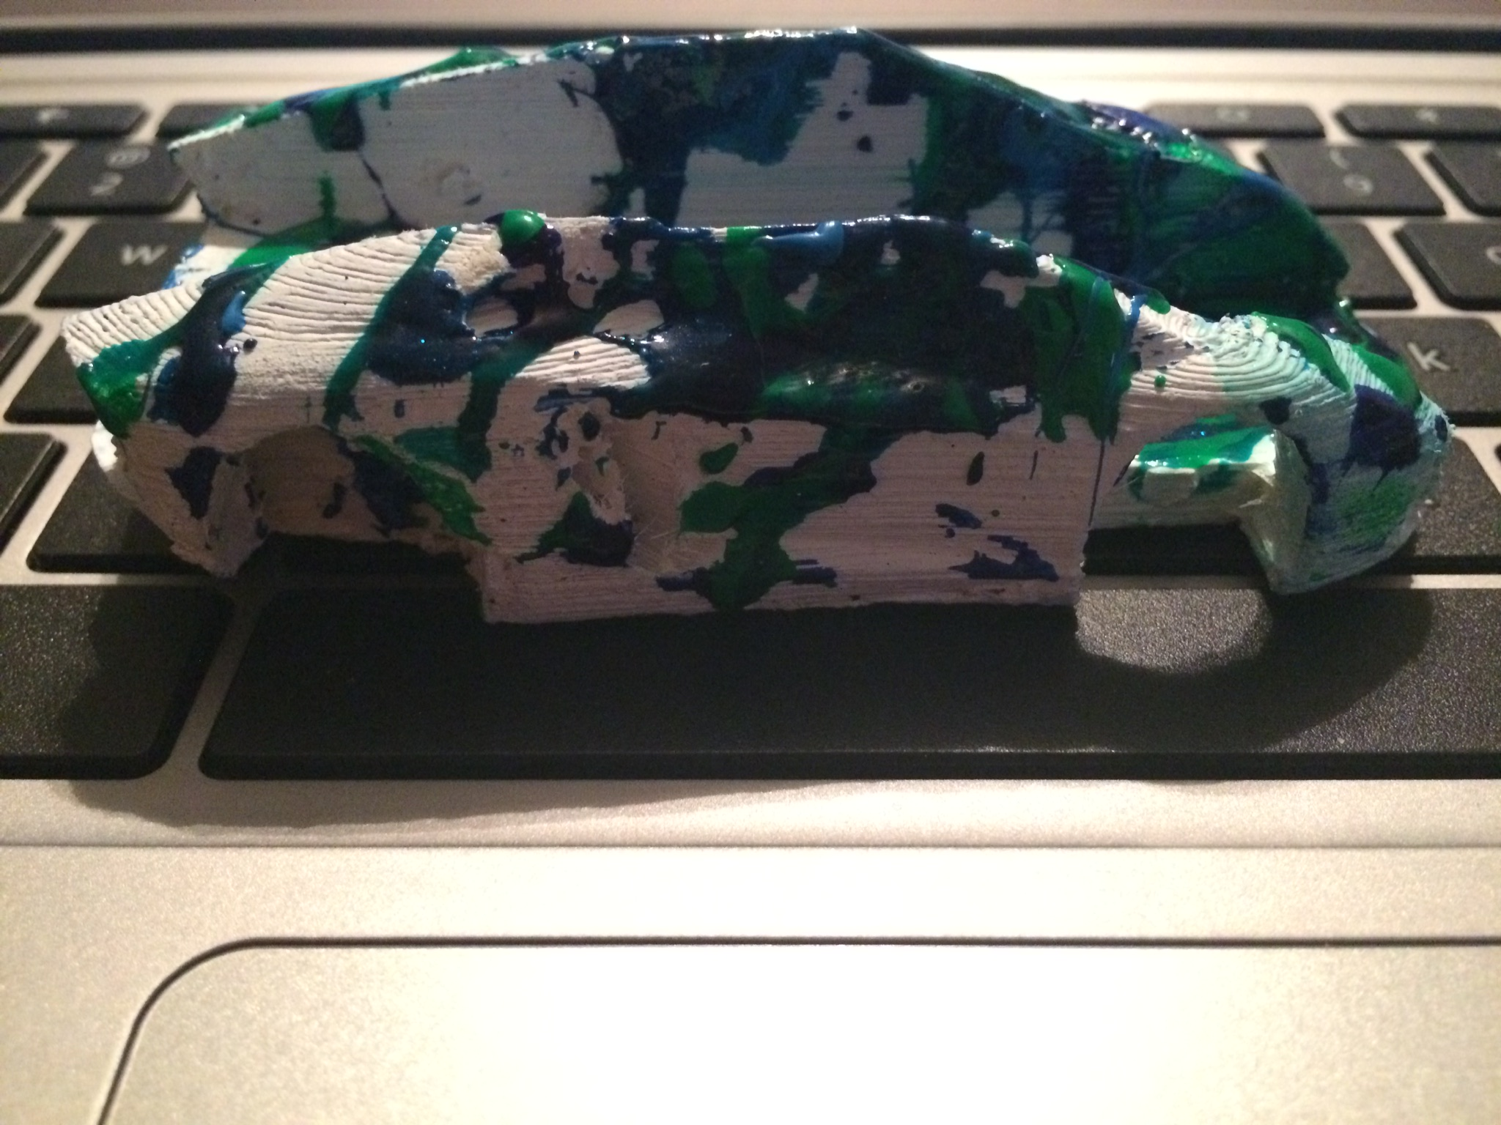
The painted version of the smaller 3D printed car.

Slide 9
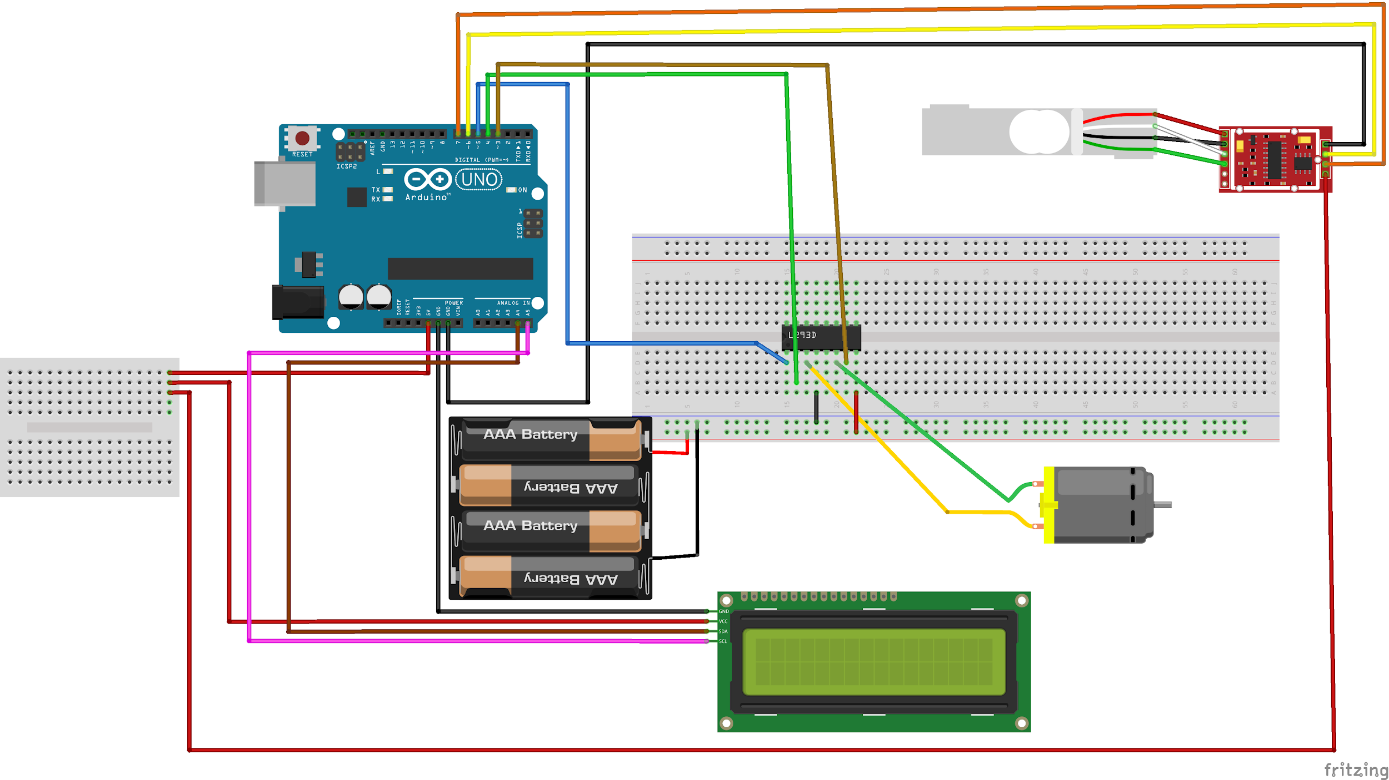
The diagram of our arduino setup.

